Slide 1
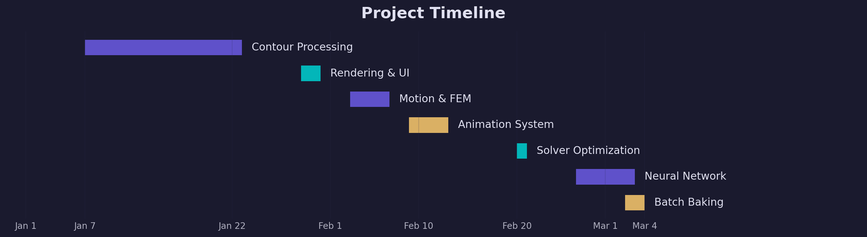
Muscle Imitation Learning
Project Timeline
989 commits · 24 working days · January – March 2026

Slide 2
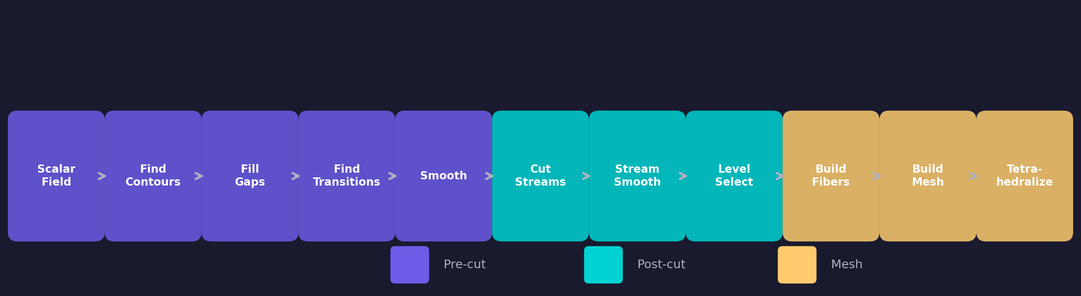
PHASE 1
Contour Processing Pipeline
January 7–22 · 12 days
→ Scalar field contour detection
→ Gap filling and transition detection
→ M-to-N cutting for complex topologies
→ Bounding plane optimization
→ Cut → Select → Build Fibers pipeline
→ Manual cutting window & Neck Viz
→ Mesh stitching and tetrahedralization

Slide 3
PHASE 2
Rendering & UI Polish
January 29–30 · 2 days
→ Two-pass face culling for transparency
→ Vertex array drawing optimization
→ Bulk muscle UI by L/R pairs & body parts
→ 1:1 simple muscle edge case handling

Slide 4
PHASE 3
Motion Playback & FEM Simulation
February 3–6 · 3 days
→ BVH motion browser with joint mapping
→ Per-frame tet deformation baking
→ Waypoint system for fiber tracking
→ Refactored ~6,680 lines into zygote_mesh_ui.py
→ Mesh quality: disconnected verts, gap closing

Slide 5
PHASE 4
Pipeline Animation System
February 9–12 · 4 days
→ 10+ animated visualization steps
→ Compute-then-replay architecture
→ Quaternion slerp for BP interpolation
→ Play All with state management

Slide 6
PHASE 5
ARAP Solver Optimization
February 20 · 1 day
→ Fused Taichi kernels & CSR gather
→ Warm-starting from previous frame
→ Reduced free-DOF system with scipy splu
→ Topology caching eliminates per-frame rebuild

Slide 7
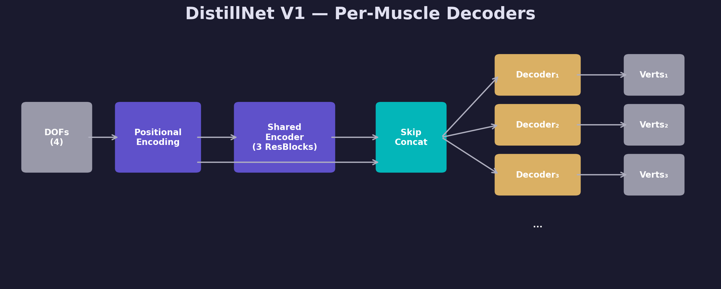
PHASE 6
Neural Network Distillation — V1
February 26 – March 3 · Per-muscle SIREN → LeakyReLU residual blocks
→ Separate decoder per muscle
→ 4 DOF input (hip + knee)
→ Raw vertex coordinate output
→ SIREN diverged → LeakyReLU ResBlocks

Slide 8
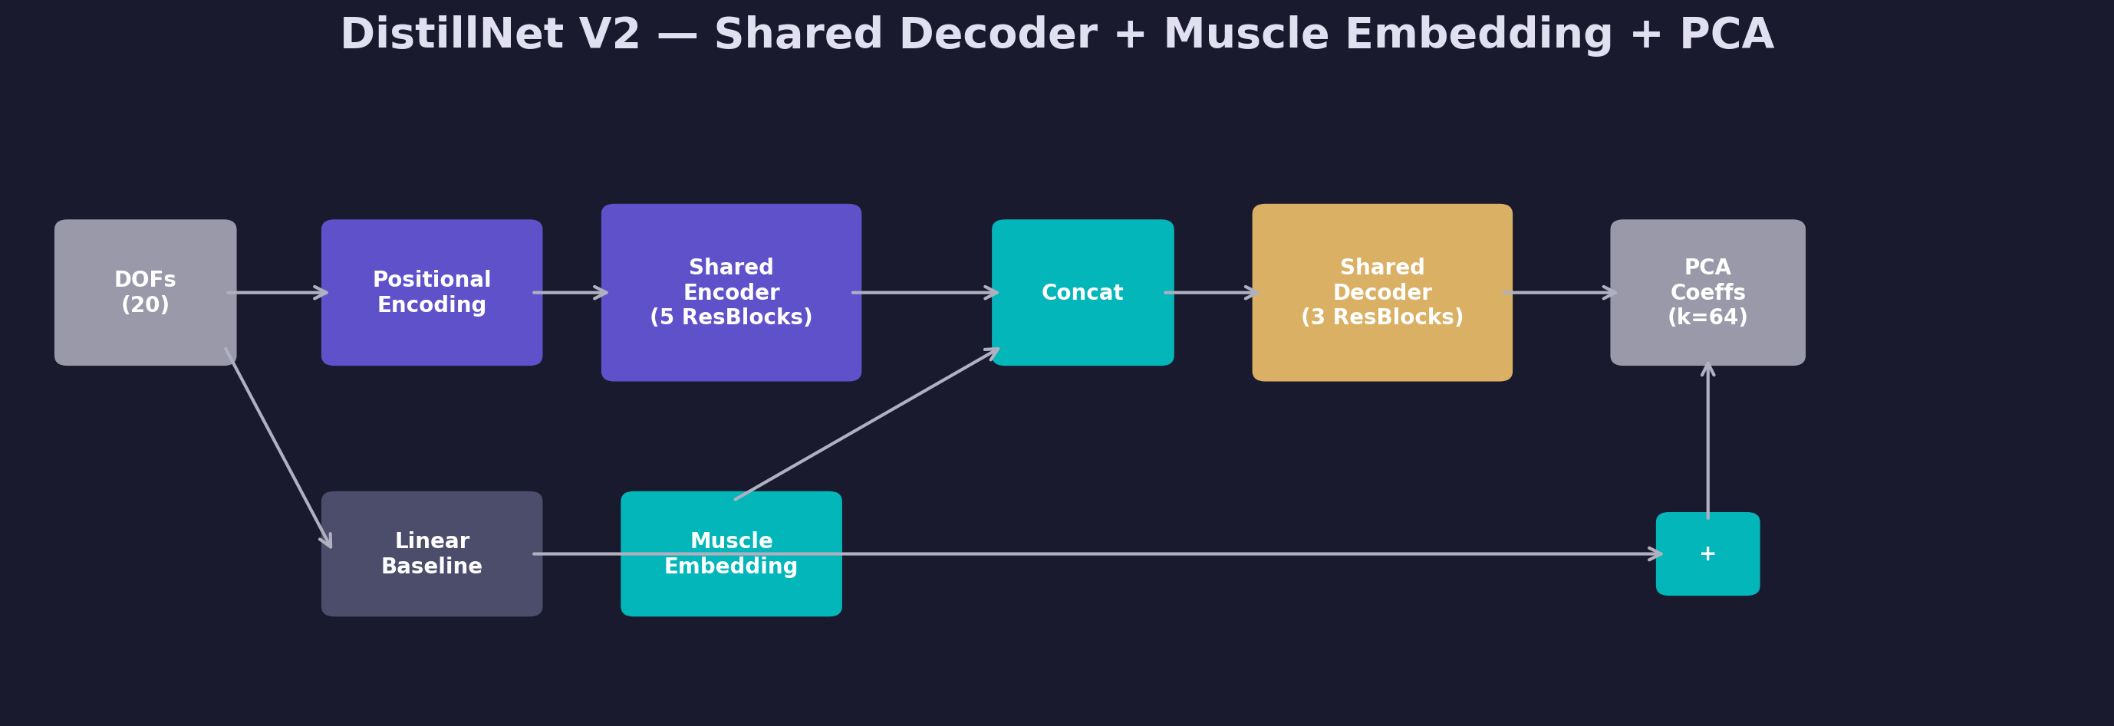
PHASE 6
Neural Network Distillation — V2
Shared decoder + muscle embedding + PCA output
→ Single shared decoder with muscle embeddings
→ 20 DOF input with sliding window (W=5)
→ PCA coefficient output (k=64)
→ Linear baseline + residual learning
→ Temporal consistency loss

Slide 9
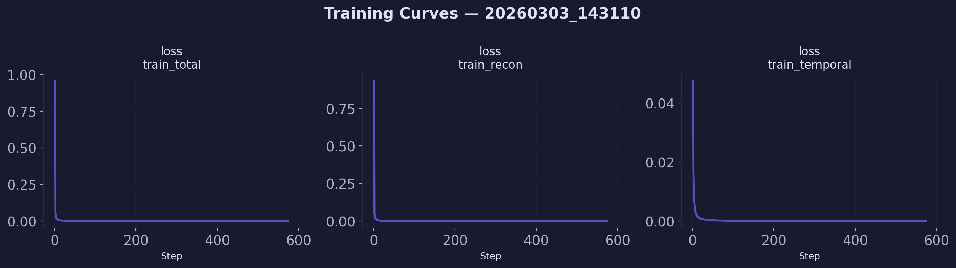
Training Results
V2 combined dance + locomotion training
→ Rapid convergence: reconstruction and temporal losses drop within first 100 steps
→ Cosine decay schedule, dropout 0.1, input noise augmentation (σ=0.02)
→ Real-time NN inference replaces expensive per-frame FEM simulation

Slide 10
PHASE 7
Batch Baking at Scale
March 3–4 · 2 days
→ 82 BVH files × 4 muscle regions
→ 5 GPUs via Slurm (RTX 6000 Ada)
→ Per-region parallel: L/R UpLeg, L/R LowLeg
→ Sync-and-delete: 84 GB server → 115 GB output
→ Disk space guards with auto-cancellation

Slide 11
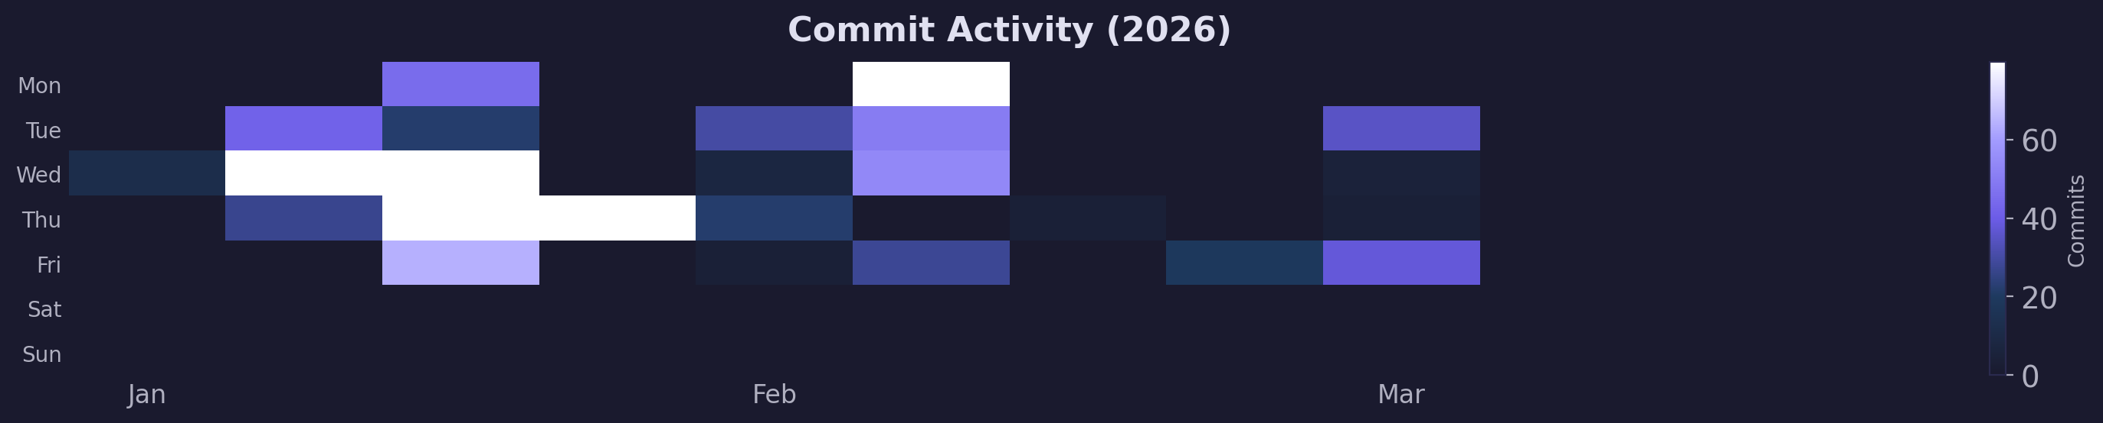
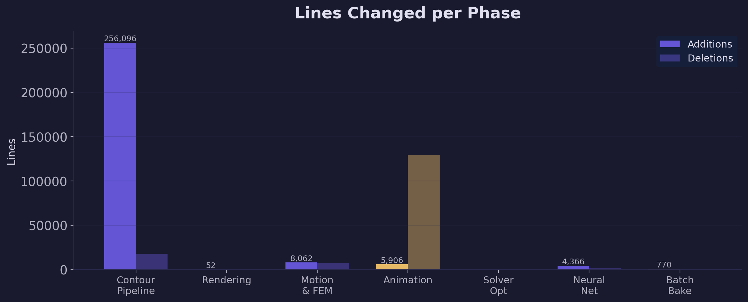
Development Activity

Slide 12
Summary
989
24
7
Commits
Working Days
Phases
Contour Processing → Rendering → Motion & FEM Simulation
Animation System → ARAP Solver Optimization
Neural Network Distillation (V1 → V2) → Batch Baking at Scale

